Slide 1
Territoriella perspektiv på den gröna industrialiseringen
Sverker Lindblad
Landsbygds- och infrastrukturdepartementet

Slide 2
Vad menas med grön industrialisering?

Slide 3
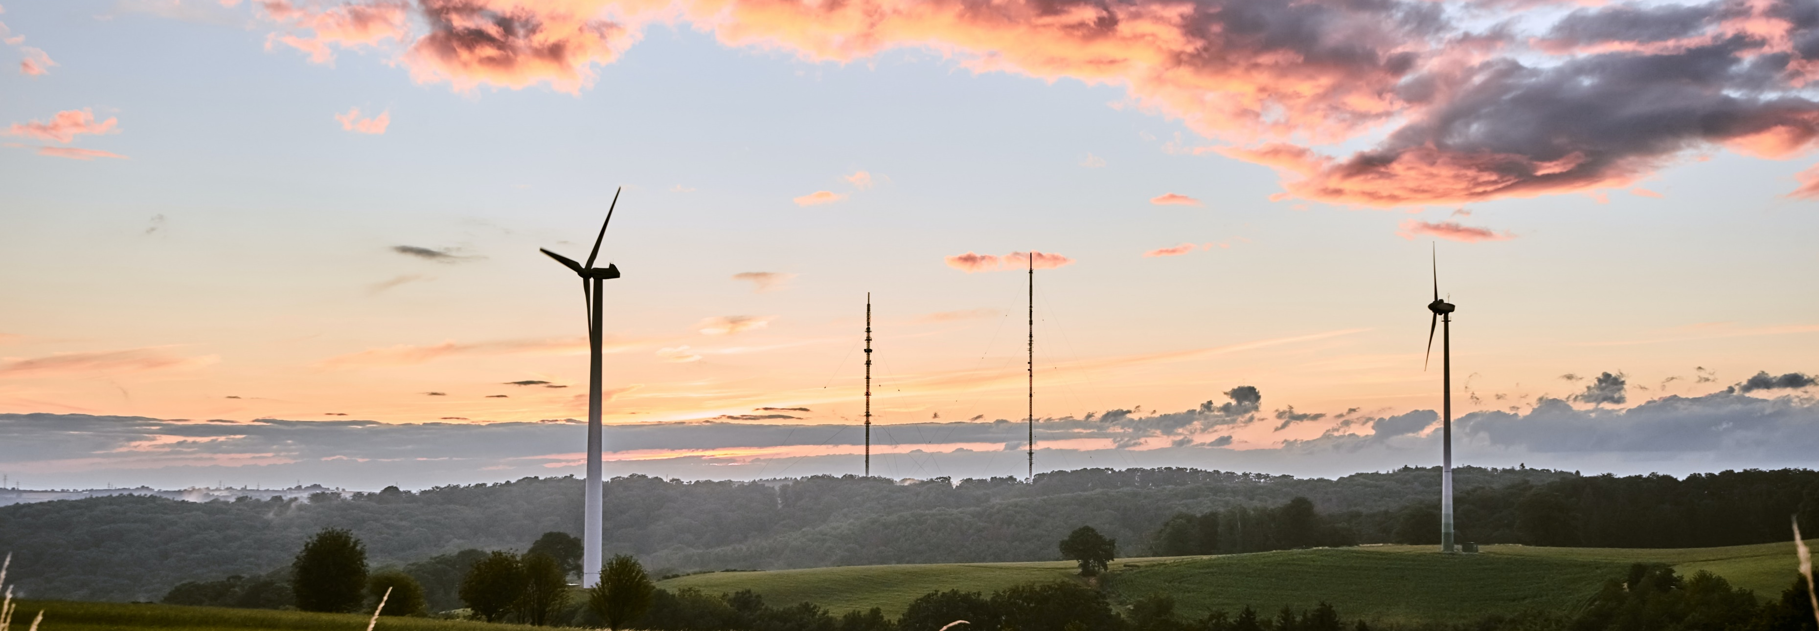
Green industrialisation: definition
Green industrialisation = the process to achieve green industries
Green industries = promoting sustainable patterns of production and consumption
    Resource and energy efficient
    Low-carbon and low waste
    Non-polluting and safe
    Products are responsibly managed throughout their lifecycle
Benefits: climate goals, international competitiveness, resilience, cheap energy, increased health and wellbeing, green jobs
Important transformations are needed:
    From fossil fuel to renewable energy sources
    Increase in resource efficiency
    Transition to a circular economy
Picture source: Bastian Pudill, Unsplash

Slide 4
Varför behövs den gröna industrialiseringen?

Slide 5
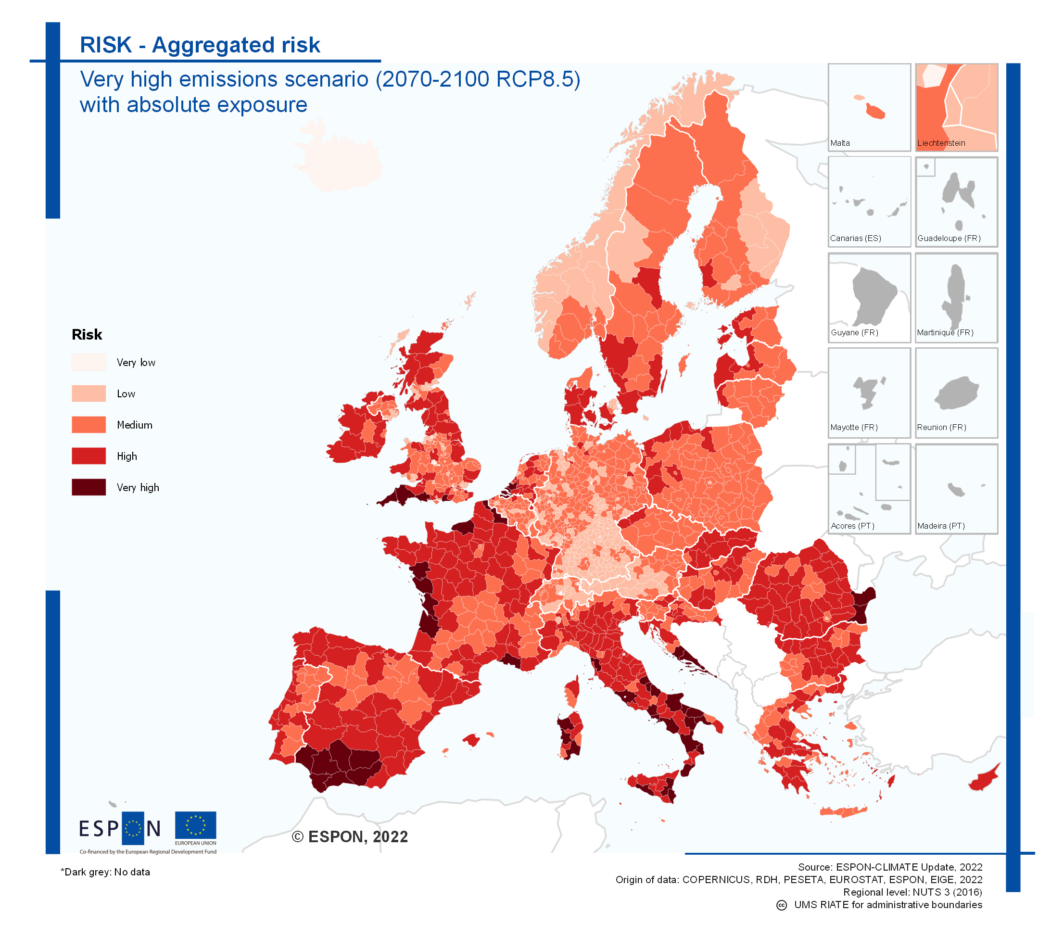
Why do regions need green industrialisation?
Risk for regions to be affected by climate induced hazards increases towards end of 21st century
  ecosystems, economic sectors, human health and wellbeing continue to be adversely impacted
  regions continuously need to improve their adaptive capacity
European Green Deal aims at climate-neutral Europe by 2050
Green industrialisation plays vital role in transition
Clean energy required for transition to green production
Higher energy prices in wake of Ukraine war accelerated need for energy transition
Strong policies and market conditions key in renewable energy deployment

Slide 6
Varför görs det så stora investeringar i norra Sverige?

Slide 7
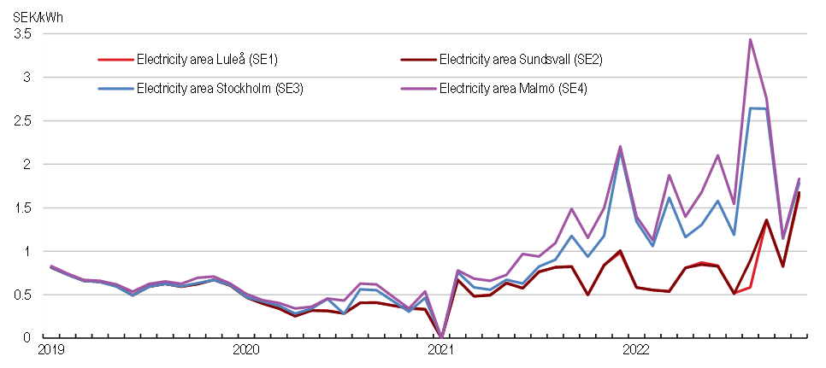
Electricity prices for apartments - monthly averages by electricity area
Source: Statistics Sweden

Slide 8
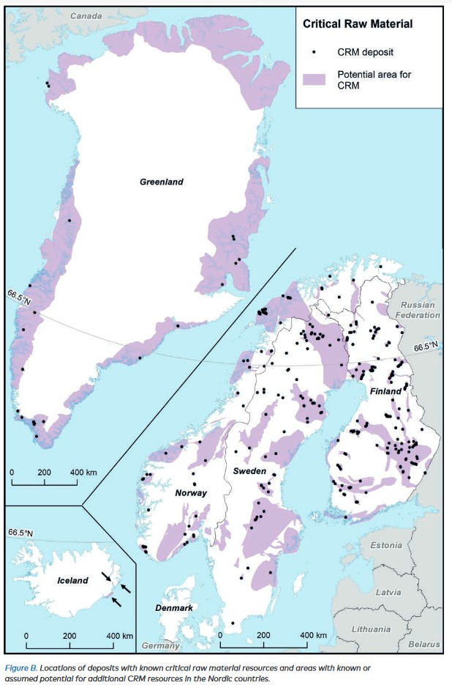
Green transition in Sweden
Transition on its way: -27% decrease in greenhouse gas emissions from production since 2008
More efficient production technologies, use of renewable energy sources, green innovation, changed consumption patterns
Green investments in northern Sweden: around 98 billion Euro committed (Fossil free steel: Hybrit in Lulea and Gällivare; Green industrial park: Haraholmen in Piteå, Europe‘s largest onshore windfarm: Markbygden in Piteå, Climate-neutral industrial area, battery production: Northvolt in Skellefteå, Electrical aviation: Skellefteå, etc.)
Key factors: Accessible and cheaper renewable energy and supply of raw materials (2023: LKAB mining company announced the discovery of a one million tonnes deposit of rare earths in Kiruna)
Challenges: meeting the increasing demand for renewable energy, access to raw material essrential for green technologies, incl. wind turbines and electric vehicles; domestic material consumption, insufficient grid capacity for electric infrastructure
Source: Pasi et al. (2021)

Slide 9
Vilka är utmaningarna?

Slide 10
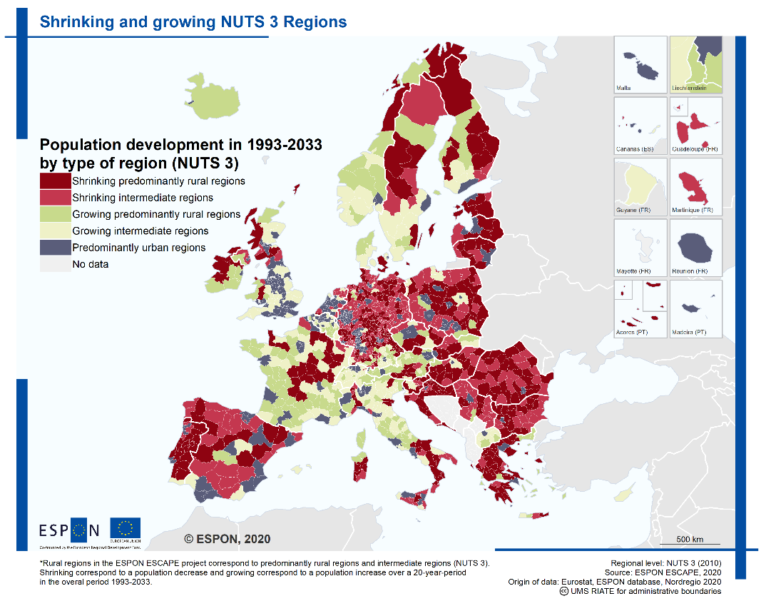
What do regions need to achieve green industrialisation? (1/5)
3.1 Demography, employment and shortage of skilled labour – a zero sum game?
Many host regions affected by decades of shrinking and ageing, economic decline, reduced access to services and loss of attractiveness.
Green industrialisation could reverse this downward spiral development, create new jobs, attract people from other regions and overall improve regional attractiveness.
BUT: shortage of qualified staff in public administration can be a limiting factor.

Slide 11
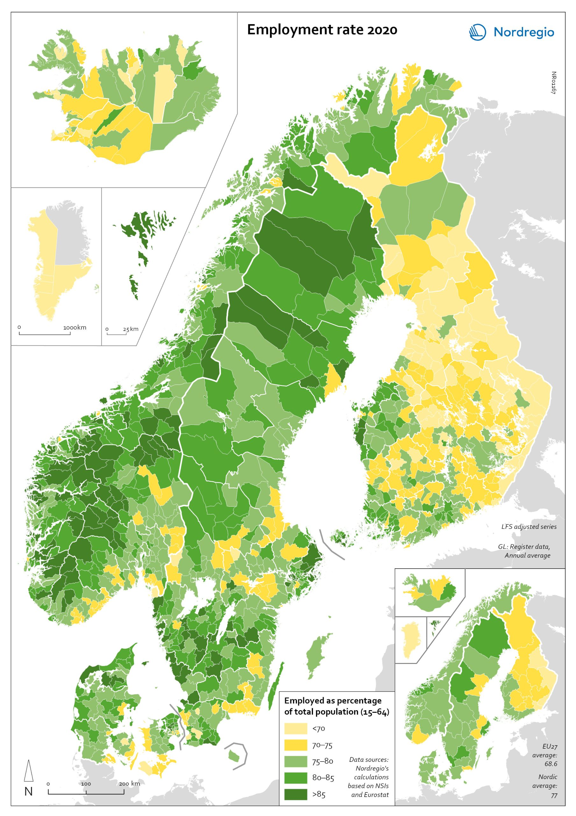
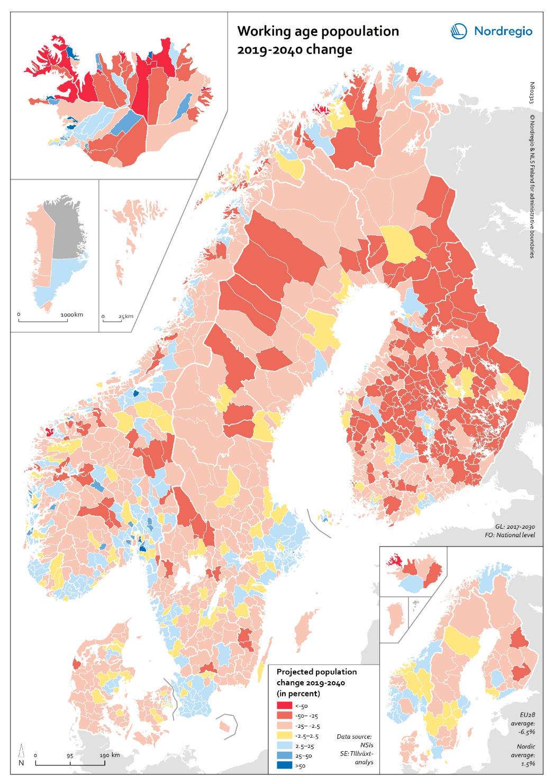
Andel sysselsatta 2020
Befolkning 15-64 år 2019-2040

Slide 12
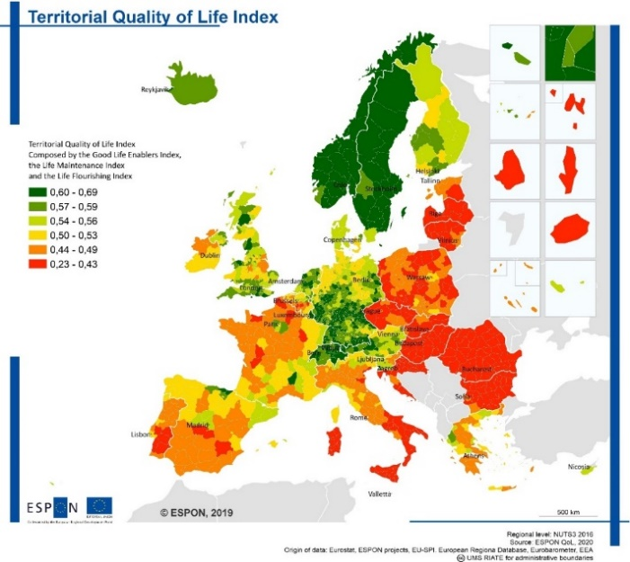
What do regions need to achieve green industrialisation? (2/5)
3.2 Planning for the sustainable society – housing, local attractiveness and social sustainability
Attractive regions offer affordable housing, access to wide range of services and infrastructures and appealing environment.
Difficult task for municipalities/regions with very limited financial resources and uncertainty if investments will pay off.
Social sustainability is key to avoid exclusion of established resident population.
Visioning can be a useful tool for steering growth development in an integrated way and could define limits to growth.

Slide 13
What do regions need to achieve green industrialisation? (3/5)
3.3 Land take – land use conflicts and divergent interests
Green industrialisation requires (new) land, but land is limited → activate brownfields for new land use demands
Changing land requires trade-offs between different interest groups as well as economic, environmental and social issues → safeguard sustainability with SEA
Sustainable energy production → example of a ‘positive zoning’ and monitoring tool by Salzburg (AT)
Reconciling spatial conflicts → make an inventory of competing users and use SIMP tool to identify and manage social impacts together with relevant stakeholders (Social Impact Management Planning)

Slide 14
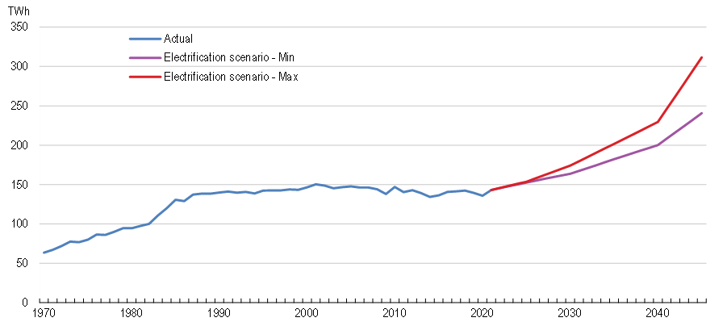
Electricity demand could roughly double by 2045
Source: Statistics Sweden; Gode et al., 2021

Slide 15
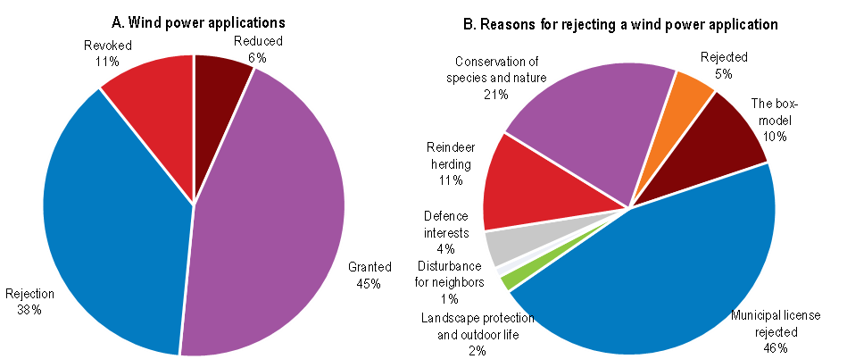
Around half of wind power applications are approved (2014-2021)
Source: Westander, Risberg and Henryson (2022).

Slide 16
What do regions need to achieve green industrialisation? (4/5)
3.4 Territorial governance – how to obtain tangible local benefits?
Natural resources should not only be used for the greater good but also provide tangible local benefits → avoid creating geographies of discontent
Key factors for managing the impacts of green industrialisation in rural regions → coordination of policies and actions & capacity building for governance at local level
Local Benefit Analysis Toolbox (REGINA project) → maximise local economic benefits from large-scale, resource-based industries → local communities can better prosper from their natural advantages
Take into account potential asymmetric impacts using TIA → increase effectiveness & efficiency of the policy → increase political support for a policy & boost its benefits

Slide 17
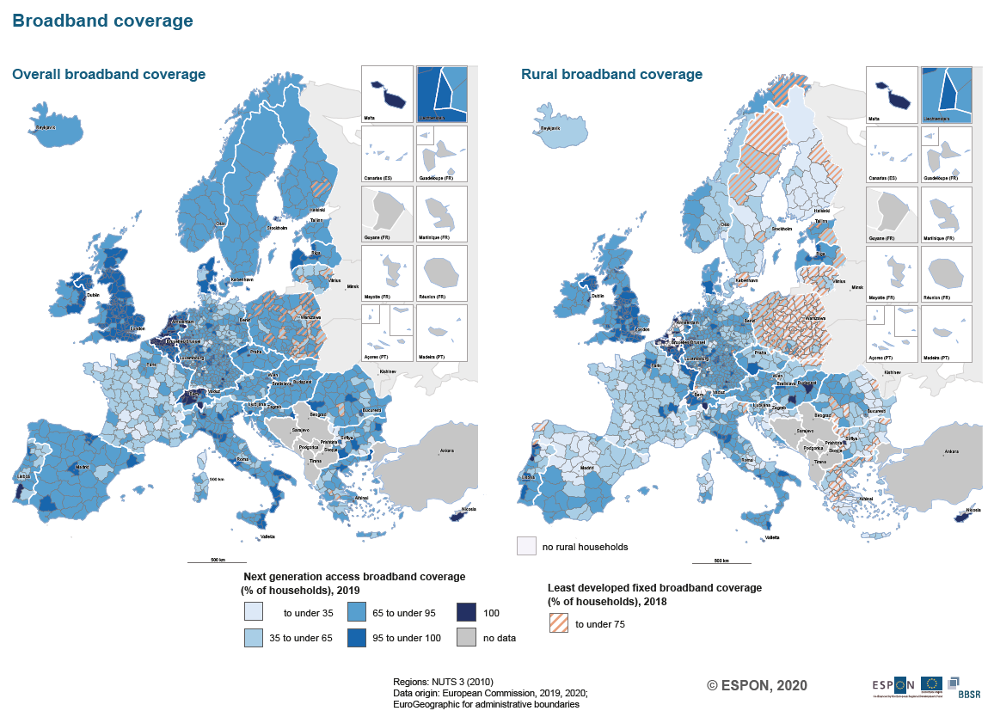
What do regions need to achieve green industrialisation? (5/5)
3.5 Digitalisation in public service provision and planning – good connections needed
Broadband coverage of rural areas stays behind - 100% fast broadband coverage in rural areas by 2025 (EC Rural Vision)
Digitalisation in health and social care - improve economic efficiency, quality of services & health and wellbeing of citizens (in remote areas)
Digital cooperation platforms - support the set-up of industrial symbiosis and circular flows (matchmaking for SMEs, sharing knowledge, etc.)
Digitalising the planning process with digital plan data and a digital plan portal - increase transparency and participation

Slide 18
Conclusions and policy advice
Co-created through expert exchange at the ESPON seminar in Luleå on 14-15 June 2023
Based on analytical findings and practical examples (success stories in different territorial contexts) discussed in working sessions:
    How to manage the U-turn? Demography, employment and skilled labour
    How to improve local attractiveness? Housing, services of general interest and quality of life
    How to address land use conflicts? Land take, environment and historical land use
    How to govern green transition? Urban-rural connections and cohesion
    How can digitalisation help? E-health, digital innovation, public service provision
    How to solve financial issues?

Slide 19
Några slutsatser
Den gröna omställningen är nödvändig för vår överlevnad!
Den gröna industrialiseringen är en del i detta och potentialen i Sverige är stor – även som förebild och gott exempel
Utmaningarna är många:
- Kompetensförsörjningen – en fråga om demografi, attraktionskraft och politik
- Social hållbarhet – bostäder och välfärdssystem
- Räcker elen – var och hur produceras den?
- Kritiska råvaror – var och hur produceras de?
- Landkonflikter
- Hur påverkas landsbygden utanför pendlingsomlandet?
Samhällsplanering – en nyckel!
Involvera befolkningen!

Slide 20


Tack för ordet!

